Slide 1
SmartPlant 3D Common Task

Slide 2
Agenda
SmartPlant 3D Introduction
Templates/Session Files
Filters (Database query)
Views
Common Toolbar
Selecting Objects
Surface Style Rules
WBS Items
Common Toolbar
© 2006. Intergraph Corporation. All Rights Reserved.

Slide 3
Agenda Cont’
Space management
Inserting Reference Files
Placing Control Points
Interference Detection
© 2006. Intergraph Corporation. All Rights Reserved.

Slide 4
SP3D Intro: Database Architecture
Report Database set
Site Database:
Contains names of plants and catalog, model and report databases associated with them.
Catalog Database:
Contains the reference data that is used by all disciplines.
Model Database: Contains design information
Report Database : Collection of views on the plant, site and catalog.
Site Database set
Catalog Database set
Model Database
© 2006. Intergraph Corporation. All Rights Reserved.

Slide 5
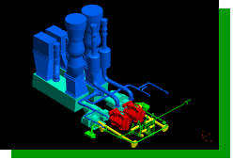
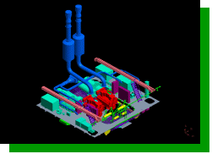
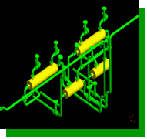
SP3D Intro: Single Database Set
SYSTEM
File boundaries inhibit
access to data.
SYSTEM
Single
Logical
Database
CAD
File
CAD
File
Model
Database
CAD
File
CAD
File
CAD
File
CAD
File
CAD
File
CAD
File
CAD
File
CAD
File
CAD
File
CAD
File
CAD
File
CAD
File
CAD
File
CAD
File
CAD
File
CAD
File
CAD
File
SPACE
ASSEMBLY
SPACE
ASSEMBLY
Databases provide easy access to
arbitrary subsets of data.
© 2006. Intergraph Corporation. All Rights Reserved.

Slide 6

SP3D Intro: Database Query
Where did my design file go?
Define Workspace (filter on database):
See only the data you want to see
Builds a logical “Working Set”
  System
  Assembly
  Spatial (Volume or Planes)
  Logical Permission Group
  Object Types/Properties
Saved Session Files
Report Database set
Workspace
Model Database
Site Database set
Catalog Database set
Display
© 2006. Intergraph Corporation. All Rights Reserved.

Slide 7
SP3D Intro: Database Architecture
Catalog 1
Model 1
Site 1
Report 1
Model 2
Report 2
Multiple Plants can rely upon the same Catalog.
Catalog 2
Model 3
Report 3
© 2006. Intergraph Corporation. All Rights Reserved.
© 2007. Intergraph Corporation. All Rights Reserved.

Slide 8
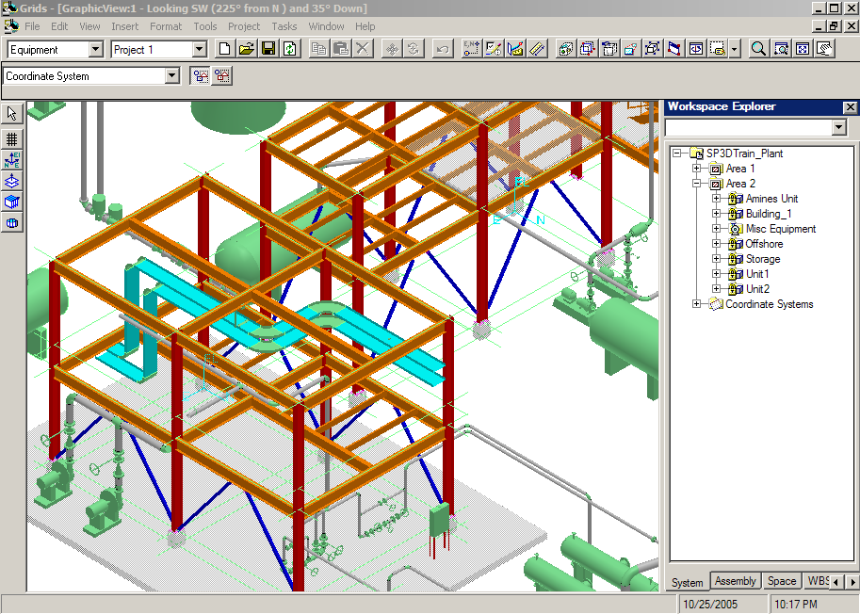
SP3D Intro: Common Windows Based User Interface
SmartPlant “Task” Oriented Interface
Common Windows Interface
Ribbon Bars
Graphic Views
Main Menu
Access
Control
Common Toolbar
Workspace
Explorer
Active
command Ribbon bar
Task Toolbar
Active View
Status Bar
© 2006. Intergraph Corporation. All Rights Reserved.

Slide 9
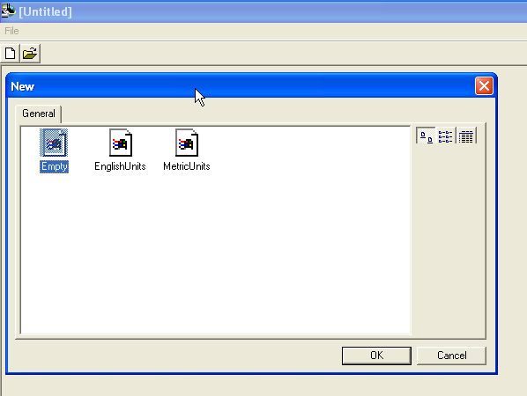
Templates: New Session Templates
Whenever you create a new session, you are working with templates. In this context, a template is a standard workspace file that a user has placed in the templates folder; you use a template as a pattern to assemble the parameters you want for a new work session.
New Session Templates
Store option settings
Store Tasks Lists Settings
Views
Background colors
And more
© 2006. Intergraph Corporation. All Rights Reserved.

Slide 10

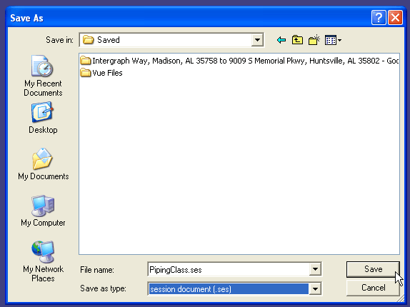
Templates: Session Files
When the save command is selected while in the SmartPlant 3D interface a dialog box will prompt immediately asking for the desired path for the .ses file:
© 2006. Intergraph Corporation. All Rights Reserved.

Slide 11
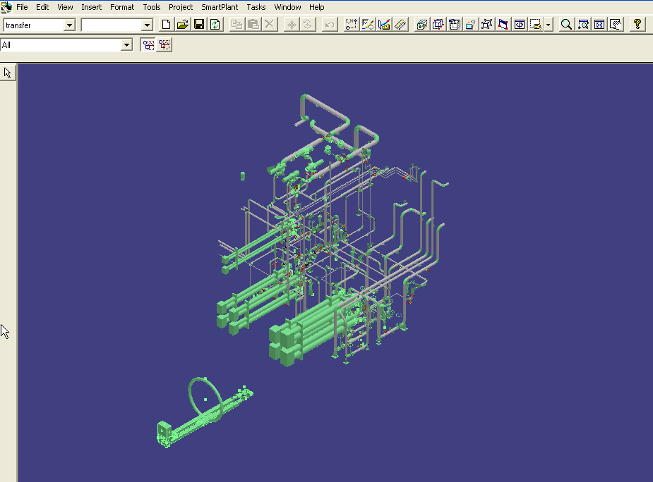
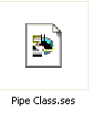
Templates: Session Files cont’
Once the .ses file path has been specified all of the 3D model data displayed in the model workspace as well as options task list and graphical views will be stored in a session file.
© 2006. Intergraph Corporation. All Rights Reserved.

Slide 12
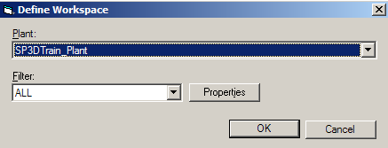
SmartPlant 3D Interface
  Define Workspace Command - (Ctrl +W)
Select the model database
Edit Existing Filter
Select or create new filter
© 2006. Intergraph Corporation. All Rights Reserved.

Slide 13
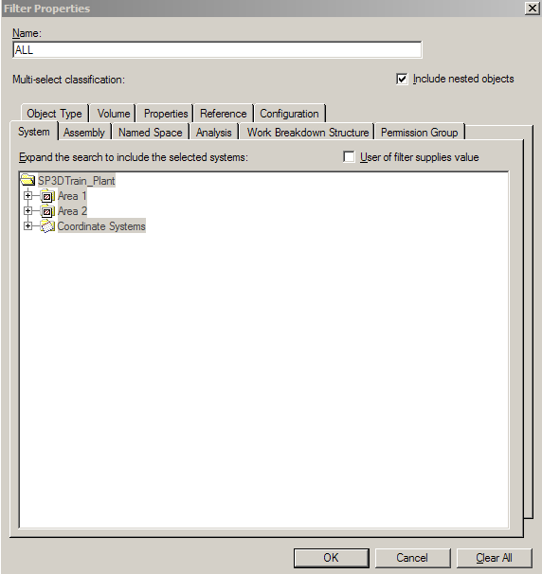
Filters
A filter is a set of search criteria that selects or retrieves data based on the
object properties:
  System
  Assembly
  Named Space
  Work Breakdown Structure (WBS)
  Analysis
  Permission group
  Object Type
  Spatial (Volume)
  Reference
  Properties
  PDS (If PDS project attached)
DB2
DB1
DB3
Workspace
See only the data you want to see.
© 2006. Intergraph Corporation. All Rights Reserved.

Slide 14
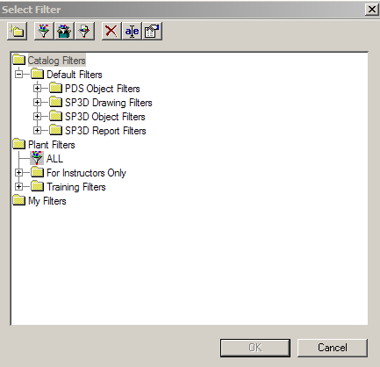
Filters
  Catalog Filters are filters which are stored in the catalog and are available to all users that use the same catalog
  Plant Filters are filters available to all users in a model. These filters are stored in the model database
  My Filters are created by the user and are only visible to him. These filters are stored in the model database
Catalog Filters
Plant
Filters
My
Filters
© 2006. Intergraph Corporation. All Rights Reserved.

Slide 15
Filters
Compound
Filter
Simple
Filter
SQL
Filter
Simple Filters
Simple Filter is a query based on the object properties defined through GUI
Compound Filters
A “Compound” filter is two or more filters with an operator between them.
SQL Filters
Is a filter which provides a place to store user-written SQL query
© 2006. Intergraph Corporation. All Rights Reserved.

Slide 16
Filters
Rename
Delete
  New Folder
  New Filter (Simple or Asking)
  New Compound Filter
  New SQL Filter
  Delete
  Rename
  Properties
Properties
Folder
© 2006. Intergraph Corporation. All Rights Reserved.

Slide 17
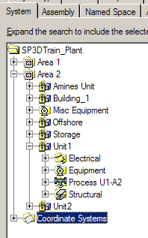

Filter Properties
System Tab
Expand the search to include all selected systems
  A system is a way to group objects logically – e.g. by discipline, by design area, by physical area, etc
  Every object must belong to a system
  System Types
© 2006. Intergraph Corporation. All Rights Reserved.

Slide 18
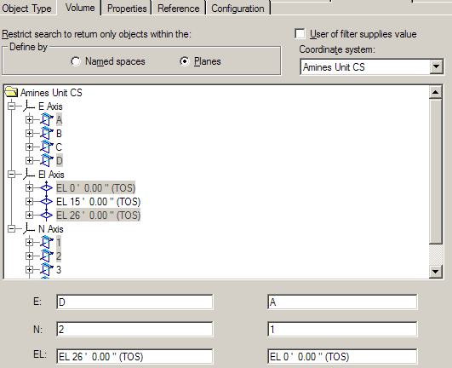
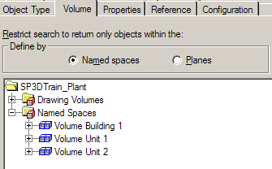
Filter Properties
Volume Tab
Restrict the search to return only objects within the volume
© 2006. Intergraph Corporation. All Rights Reserved.

Slide 19
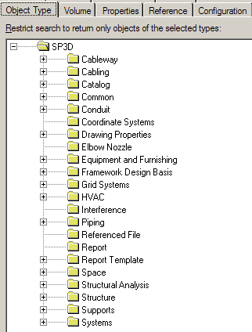
Filter Properties
Object Class Tab
Restrict the search to return only objects of the selected types
© 2006. Intergraph Corporation. All Rights Reserved.

Slide 20
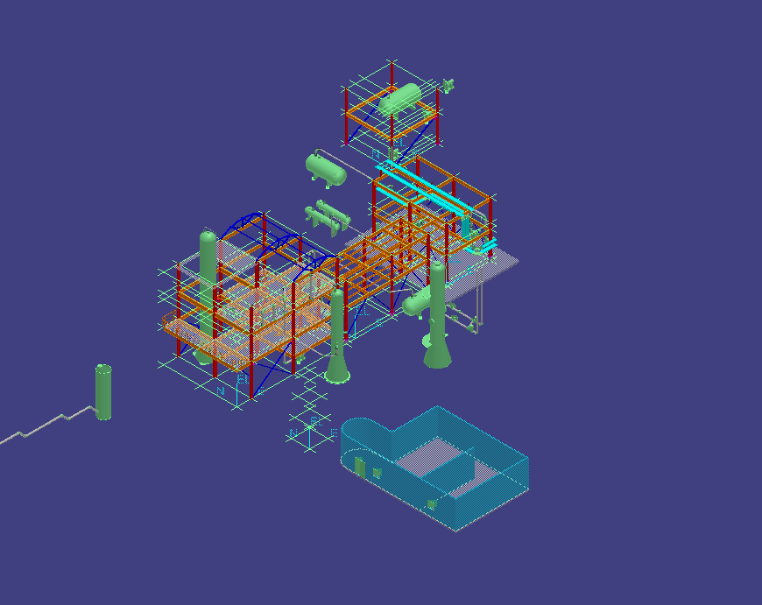
Session Templates & Filter
Session Template + Filter = Workspace/Session File
© 2006. Intergraph Corporation. All Rights Reserved.

Slide 21
SP3D Practice Labs
Creating a Session File
Defining a Workspace by a System Filter
Defining a Workspace by a Volume Filter
© 2006. Intergraph Corporation. All Rights Reserved.

Slide 22
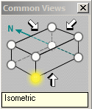
View Manipulation
Common Environment Toolbar
Common Views
Common views command allow you quickly change the view orientation to any standard isometric/orthogonal orientation
© 2006. Intergraph Corporation. All Rights Reserved.

Slide 23
View Manipulation
Common Environment Toolbar
Zoom Tool
Pan
Zoom Area
  Zoom Tool command:
- Zoom in (mouse roller ball)
- Zoom out (mouse roller ball)
- Zoom Area (left mouse click, drag and release)
- Pan (middle mouse drag)
© 2006. Intergraph Corporation. All Rights Reserved.

Slide 24
View Manipulation
Common Environment Toolbar
Fit
  Fit View command:
  Fit all visible objects within the current clipping volume in the Active View
  If objects are selected, then the command will fit only the selected objects
© 2006. Intergraph Corporation. All Rights Reserved.

Slide 25
View Manipulation
Common Environment Toolbar
Refresh
  Refresh command:
  Update your workspace definition (filter) in the Active View
© 2006. Intergraph Corporation. All Rights Reserved.

Slide 26
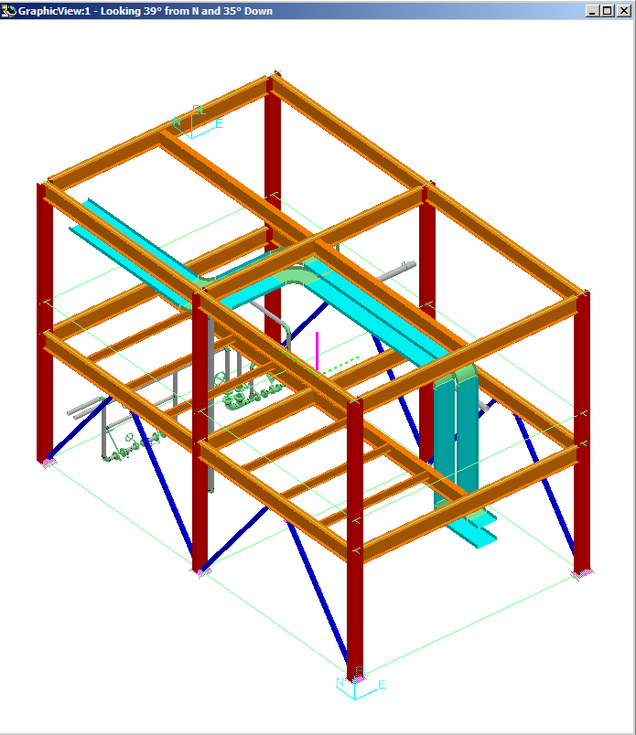
View Manipulation
Common Environment Toolbar
Rotate View
  Rotate View command:
  - Rotate the view interactively
  - Change the rotation axis
  - Change the rotation point
© 2006. Intergraph Corporation. All Rights Reserved.

Slide 27
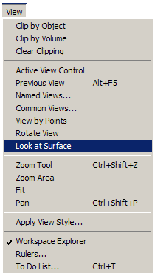
View Manipulation
  Look at Surface command:
  Rotate the active view planar to the
  selected surface
© 2006. Intergraph Corporation. All Rights Reserved.

Slide 28
View Manipulation
  Establishing Clipping Volume
  - Clipping by Object
  - Clipping by Volume
  - Clear Clipping
© 2006. Intergraph Corporation. All Rights Reserved.

Slide 29
View Manipulation
Common Environment Toolbar
Clip by Object
  Clip by Object command:
  Allows you to define the view clipping volume (rectangular parallopiped) to be the same as the object’s range box in your active view
© 2006. Intergraph Corporation. All Rights Reserved.

Slide 30

View Manipulation
Smartstep ribbon bar
Clip by Object
Accept
Select Object
Select View
Reject
  A command step is also provided to assign the same clipping volume to additional views
  Use the Shift key to select multiple objects
© 2006. Intergraph Corporation. All Rights Reserved.

Slide 31
View Manipulation
Common Environment Toolbar
Clip by Volume
  Clip by Volume command:
  Allows you to set the view clipping volume so that all objects not inside the clipped area are hidden from the selected view
© 2006. Intergraph Corporation. All Rights Reserved.

Slide 32

View Manipulation
Drag Clipping planes
Smartstep ribbon bar
Select View
Clip by Volume
First point
Second point
Third point
Four point
© 2006. Intergraph Corporation. All Rights Reserved.

Slide 33
View Manipulation
Common Environment Toolbar
Clear Clipping
  Clear Clipping command:
  Remove the clipping volume.
  It then prompts for select of the next window to clear
  The command is terminated by:
  - Right mouse click
  - Esc Key
  - Pick of another command
© 2006. Intergraph Corporation. All Rights Reserved.

Slide 34
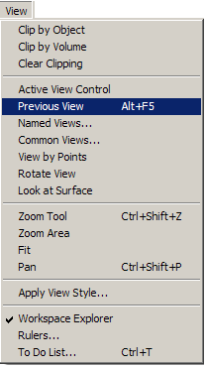
View Manipulation
Main Menu
  Restore the Previous View
© 2006. Intergraph Corporation. All Rights Reserved.

Slide 35
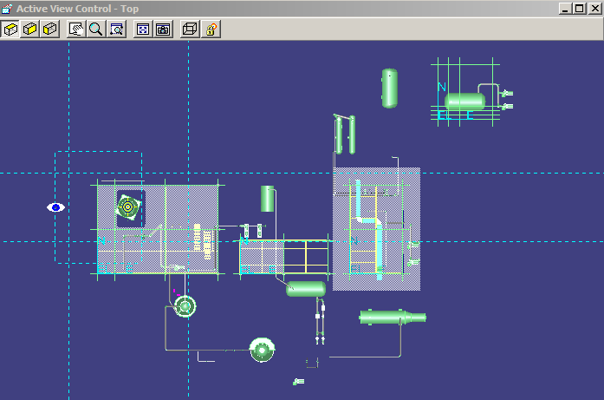
View Manipulation
Common Environment Toolbar
Active View Control
  Active View control command:
  Provides commands to dynamically control the view parameters of the active view
© 2006. Intergraph Corporation. All Rights Reserved.

Slide 36
View Manipulation
Common Environment Toolbar
Named View
Recall Views
  Saved View (Named View) command
  You can save the settings (location, orientation) of the active view so that you can apply them again later
  Recall views from the pull down on the command, four standard views supplied.
© 2006. Intergraph Corporation. All Rights Reserved.

Slide 37
View Manipulation
Common Environment Toolbar
View by 3 pts
View along line
View by pts
View by 3 Points
  - Let you pick 3 Points that define a plane
  - The plane of your screen is the plane defined above (pt3 will be located the center of the view plane)
View along line
  - Lets you pick the two points along a line.
  - The plane of your screen is the plane perpendicular to above line
© 2006. Intergraph Corporation. All Rights Reserved.

Slide 38
Measure
  Tool -> Measure
  Measure Actual or Minimum 3D linear distance between two points
  Measure delta E, N, EL distance between two points
  Measure actual angle defined by three points
  Measure radius and diameters
Measure Min Distance between objects
Measure angle between objects
Measure Rad / Dia
Define coord system
Set active Coordinate System
Measure angle between 3 points
Measure Min
Distance between points
Measure Distance along object
Displays
Relevant Data
© 2006. Intergraph Corporation. All Rights Reserved.

Slide 39
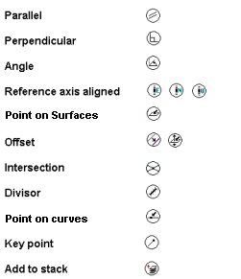
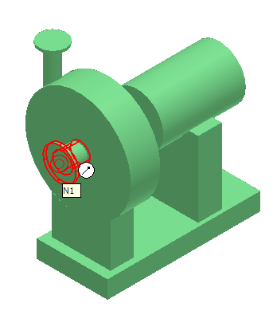
SmartSketch
SmartSketch is the mechanism to automatically find special points when the command is looking for a point.
© 2006. Intergraph Corporation. All Rights Reserved.
Notes:
Select o.oid from jdobject o join jrange r on r.oid = o.oid where r.zmax < 2

Slide 40
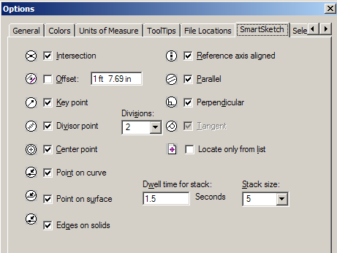
SmartSketch Options
Allows you to enable the SmartSketch indicators
© 2006. Intergraph Corporation. All Rights Reserved.

Slide 41
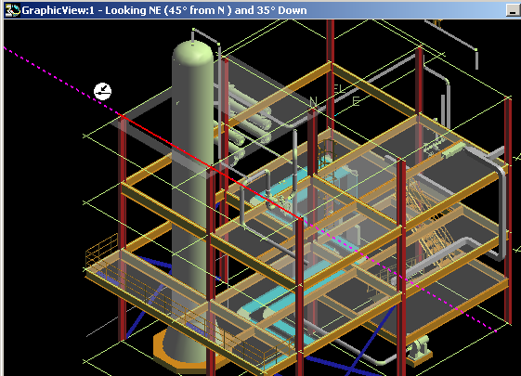
SmartSketch
  The system finds Key point and Point on Geometry whenever you move the
  cursor over those points
  System uses only those points (stored in the stack) and check for linear
  relationship points against every object in the workspace
© 2006. Intergraph Corporation. All Rights Reserved.
Notes:
Select o.oid from jdobject o join jrange r on r.oid = o.oid where r.zmax < 2

Slide 42
SmartSketch
User will have two options on what objects are located by SmartSketch
- Locate on Display List
- Locate on List Only
SmartSketch Lock Constraint
When SmartSketch is being used, a middle mouse click will lock the currently active smartsketch constraint.
- Middle mouse button (VERY USEFUL TOOL)
- Ctrl –L keys
© 2006. Intergraph Corporation. All Rights Reserved.
Notes:
Select o.oid from jdobject o join jrange r on r.oid = o.oid where r.zmax < 2

Slide 43

SmartSketch
User will have two options on what objects are located by SmartSketch
- Locate on Display List
- Locate on List Only
Clear Stack
Set Stack Size
Locate List
Toggle Display/List Only
Set Dwell Time
© 2006. Intergraph Corporation. All Rights Reserved.
Notes:
Select o.oid from jdobject o join jrange r on r.oid = o.oid where r.zmax < 2

Slide 44

Pinpoint
PinPoint
An options for moving or placing objects with precision.
Display On/Off (F9) - Displays or hides the PinPoint options and distance values. The shortcut key for this box is F9.
Reposition Target - Changes the location of the target point. The EX- and NY-coordinates are relative to a target point you define in the view. Also, you can reposition the PinPoint target by pressing F12.
© 2006. Intergraph Corporation. All Rights Reserved.

Slide 45
Common Toolbar
Common Views
Zoom Tool
Window Area
Refresh View
Active View Control
Rotate View
Looking at Surface
View by 3 points
View along line
Clipping
© 2006. Intergraph Corporation. All Rights Reserved.

Slide 46
Common Tools
Copy
Paste
Delete
Move
Rotate Object
Undo
© 2006. Intergraph Corporation. All Rights Reserved.

Slide 47
Common Tools Conti’
New Session
Open Existing Session
Save Current Session (.SES file)
Refresh Active Workspace
© 2006. Intergraph Corporation. All Rights Reserved.

Slide 48

Select Objects
  Select Command
  By Fence Inside Control
  By Fence Overlap Control
  Use shift key to add or remove objects from the select set.
  Tools -> Select by Filter
  Use Workspace Navigator
  & Quick Icon and toolbar
© 2006. Intergraph Corporation. All Rights Reserved.
Notes:
Select o.oid from jdobject o join jrange r on r.oid = o.oid where r.zmax < 2

Slide 49
Main Menu
The software's menu bar allows you to access all commands, divided by workflow or task. When you click a command, a description of the command appears in the message field at the bottom left of the main application window. You can also click the Help button on the main toolbar, and then click a menu command to view a description of that command.
© 2006. Intergraph Corporation. All Rights Reserved.

Slide 50
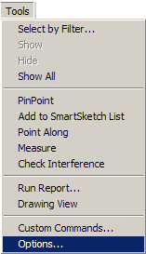
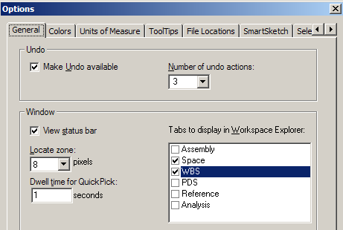
General Options
Allows you to enable the Undo command and the status bar
The activation time of the quick pick tool
Define the locate zone for SmartSketch
Define the Tabs to display in the Workspace Explorer
© 2006. Intergraph Corporation. All Rights Reserved.

Slide 51
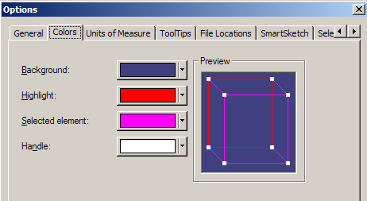
Colors Options
Allows you to select the colors the system uses for the background, Highlight and selected elements
© 2006. Intergraph Corporation. All Rights Reserved.

Slide 52
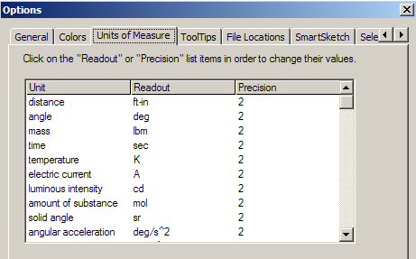
Units of Measure Options
Sets the display units
Sets the precision of the units
Everything stored in SI units in database
Units can be added to any keyed in input values
Example:
Slope: in / ft
Distance: in (fractional)
© 2006. Intergraph Corporation. All Rights Reserved.

Slide 53
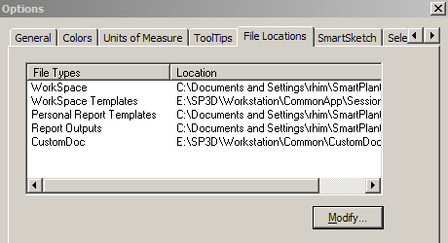
File Locations Options
File Locations
© 2006. Intergraph Corporation. All Rights Reserved.

Slide 54
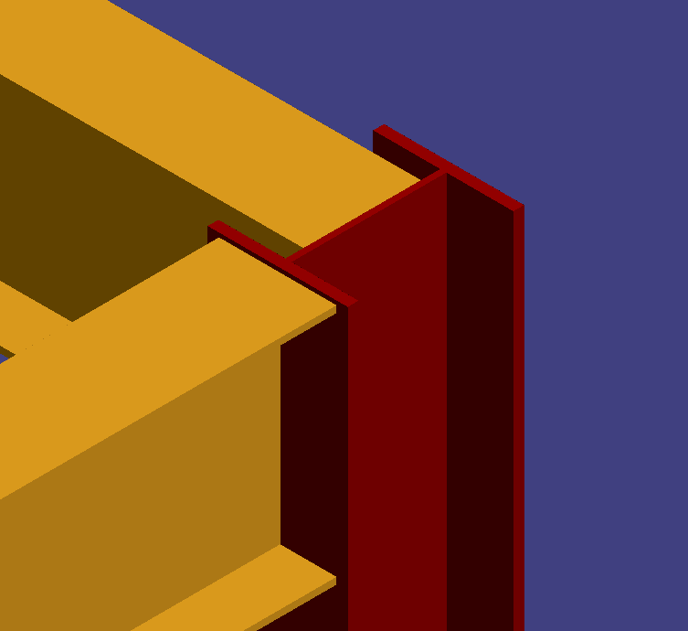

SmartSketch Options
Allows you to enable the SmartSketch indicators
© 2006. Intergraph Corporation. All Rights Reserved.

Slide 55
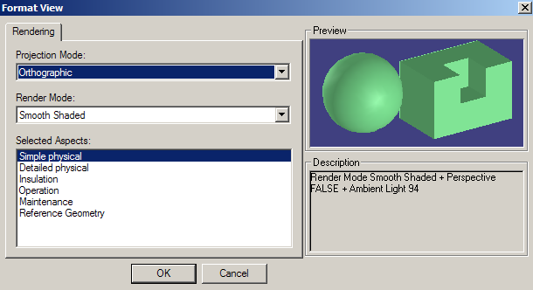

Formatting the Active View
You can format a View by defining a render mode and perspective setting
Render mode: Outline, Smooth Shaded and Shaded with Enhanced Edges
Aspect is a geometric representation for an object
© 2006. Intergraph Corporation. All Rights Reserved.

Slide 56
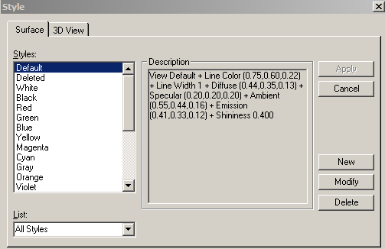
Applying Styles
Styles are collections of color, lighting, and render modes that you can apply to all views or to specific items in the views. New user styles are stored in the database
  - View Style
  - Surfaces Style
All Styles
Or
Styles used in workspaces
© 2006. Intergraph Corporation. All Rights Reserved.
Notes:
Select o.oid from jdobject o join jrange r on r.oid = o.oid where r.zmax < 2

Slide 57
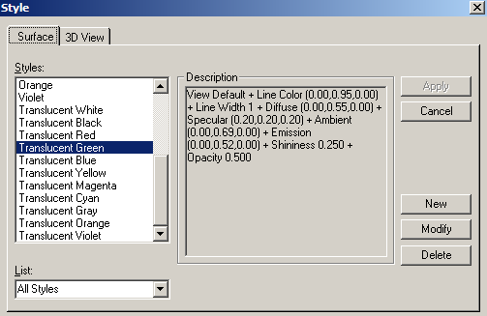
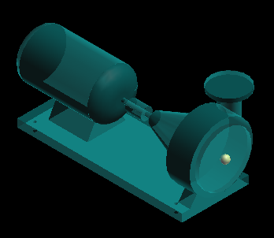
Applying Surface Style
  to Selected objects
  Using surface style rules
Translucent
Green
© 2006. Intergraph Corporation. All Rights Reserved.
Notes:
Select o.oid from jdobject o join jrange r on r.oid = o.oid where r.zmax < 2

Slide 58
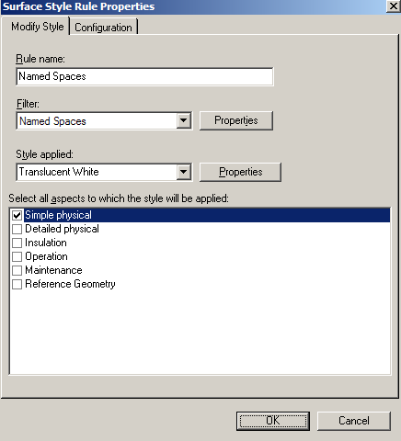
Applying Surface Style
  A Surface Style Rule consists of a filter and the named surface style to be applied to the specific aspects of the objects identified by the filter
© 2006. Intergraph Corporation. All Rights Reserved.
Notes:
Select o.oid from jdobject o join jrange r on r.oid = o.oid where r.zmax < 2

Slide 59
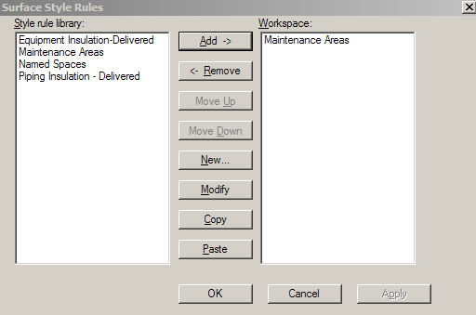
Applying Surface Style
  Surface style Rules is saved in the model database
  Surface style rule applied to the workspace is saved in the session file
  Copy/Paste functionality
© 2006. Intergraph Corporation. All Rights Reserved.
Notes:
Select o.oid from jdobject o join jrange r on r.oid = o.oid where r.zmax < 2

Slide 60
SP3D Practice Labs
Manipulating Views
Selecting Objects in a model
Applying a Surface Style Rule
© 2006. Intergraph Corporation. All Rights Reserved.

Slide 61
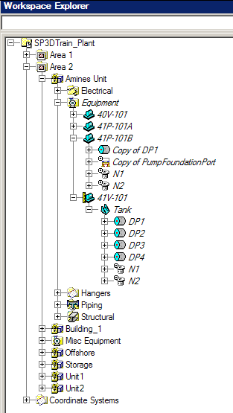
Hide/Show command
Hidden objects are displayed in Italic Text
© 2006. Intergraph Corporation. All Rights Reserved.
Notes:
Select o.oid from jdobject o join jrange r on r.oid = o.oid where r.zmax < 2

Slide 62
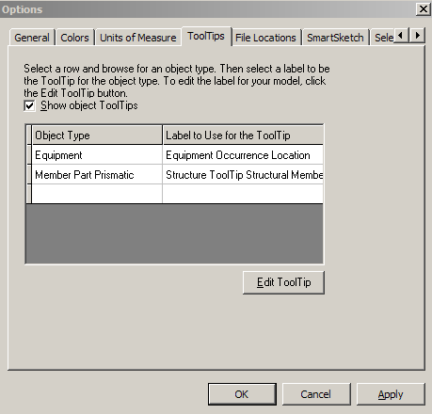
ToolTips
Label Editor
Allows to edit labels in an easy way using common User Interface
The edited label is saved in the model DB
© 2006. Intergraph Corporation. All Rights Reserved.
Notes:
Select o.oid from jdobject o join jrange r on r.oid = o.oid where r.zmax < 2

Slide 63
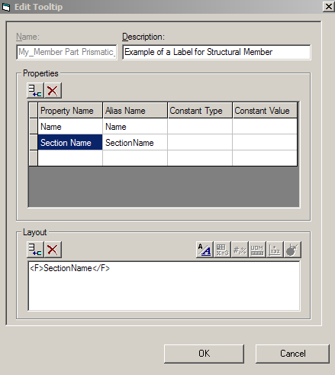
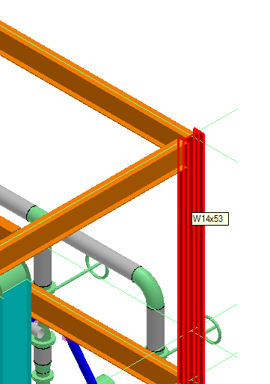
ToolTips
© 2006. Intergraph Corporation. All Rights Reserved.
Notes:
Select o.oid from jdobject o join jrange r on r.oid = o.oid where r.zmax < 2

Slide 64
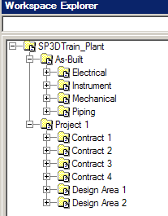
Work Breakdown Structure
  Creates a relationship in the database between each object in the select set and the selected Work Breakdown Structure (WBS) item in the workspace explorer. These relationships are displayed in the Relationship tab of the objects properties dialog box.
  WBS is an aid that assist Projects Admin., Project leads, and Project Managers with Organizing, managing and grouping several different projects within the same plant.
© 2006. Intergraph Corporation. All Rights Reserved.
Notes:
Select o.oid from jdobject o join jrange r on r.oid = o.oid where r.zmax < 2

Slide 65
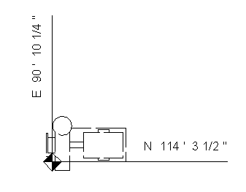
Control Points
  Definition
  A 3D object representing a point in the model
  Drive label locations on orthographic drawings
  Placement method:
    Insert Control Point Command
    Define in the Symbol Definition
  Control point location is user defined
  The position can be declared to be at a fixed global position or the positioning method can be associatively maintained.
  The control point is associative to a parent object
  Control Point graphics is a sphere that does not support interference detection
  Control Point is displayed in Reference Geometry Aspect
Control Point
© 2006. Intergraph Corporation. All Rights Reserved.
Notes:
Select o.oid from jdobject o join jrange r on r.oid = o.oid where r.zmax < 2

Slide 66
Checking Interferences
  SP3D provides two mode of operations:
  Server-based Interference checking (Database Detect).
  - Run on a separate IFC server
  - Look for all interferences for the full model
  Interactive interference checking (Local Detect).
  - Help the designer in real time
  - Local to a session (what you see in your workspace)
© 2006. Intergraph Corporation. All Rights Reserved.
Notes:
Select o.oid from jdobject o join jrange r on r.oid = o.oid where r.zmax < 2

Slide 67
Checking Interferences
  Major Differences between the two methods:
Database Detect | Local Detect
Runs all the time (System Admin. choice) | Works only within the current session
Minimizes impact on users and improves performance | Provides immediate graphical feedback (works in a dynamic mode)
Creates persistent interferences that are stored in the model database | Shows interferences when the pointer is idle for a brief amount of time; based on a hesitation approach
Based on administrator settings (controlled by permission groups) | Based on individual user settings
Provides feed back on how much has been checked | Checks only created and modified items
Users can visualize the interferences (persistent items) | Clears dynamic interferences after refreshing workspace
© 2006. Intergraph Corporation. All Rights Reserved.

Slide 68
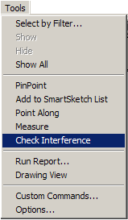
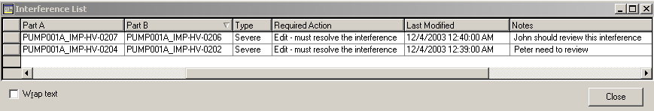
Checking Interferences
IFC is available in all Task
Very simple and intuitive GUI
Ribbon bar includes:
  Settings
  Visualization
  Review & Approval
© 2006. Intergraph Corporation. All Rights Reserved.

Slide 69
Checking Interferences
Three type of checking (based on the object aspects):
  Required
  Optional
  Not Checked
Can process:
  Required – Required
  Required – Optional
  Optional – Optional
A clearance rule can be used
© 2006. Intergraph Corporation. All Rights Reserved.

Slide 70
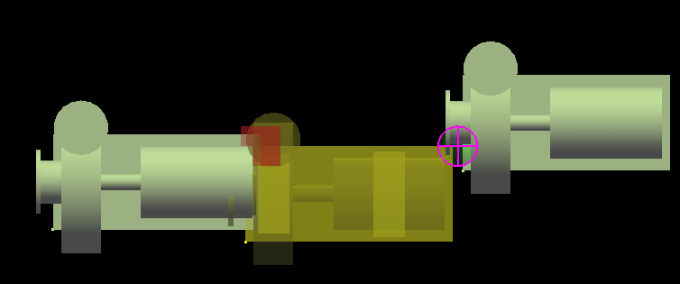
Checking Interferences
  Any persistent interference detected by the Database Detect process appears as a sphere
  Interference detected by the Local Detect process appears as a box
Local Detect
Database Detect
© 2006. Intergraph Corporation. All Rights Reserved.

Slide 71

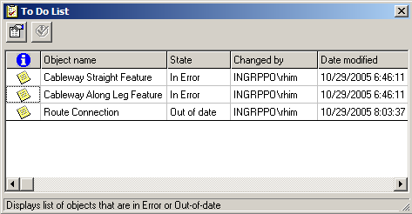
To Do List
    An object’s relationship with another object become inappropriate, the system generate an Error entry in the To Do List.
    A relationship has changed between to object, but the person who modified the objects only have write access to one of the object. The system generate an Out of Date entry in the To Do List
© 2006. Intergraph Corporation. All Rights Reserved.

Slide 72
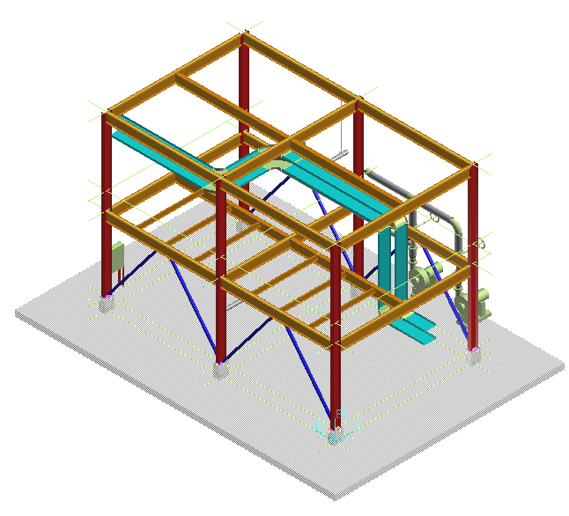
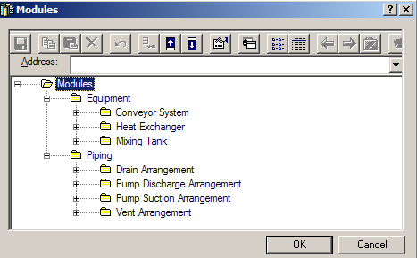
Design Re-use
Copy to Catalog
or
Instance in Another Location
Unit1
Internal Relationships Maintained.
External Relationship Exposed.
© 2006. Intergraph Corporation. All Rights Reserved.

